Slide 1

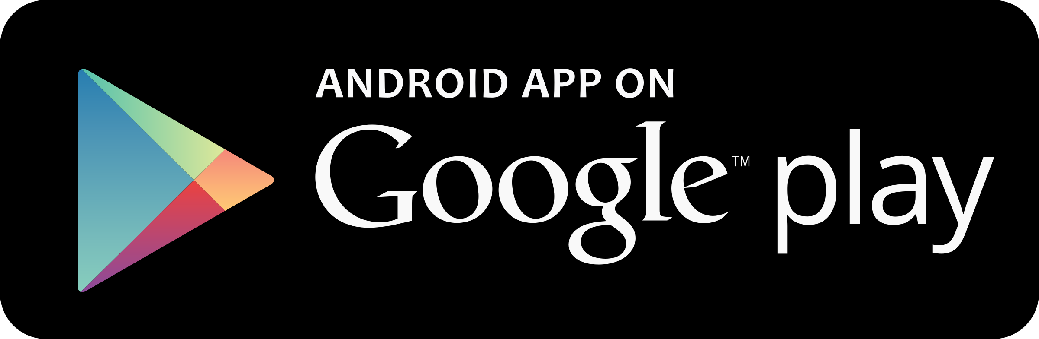
- Better Learning Together -
Hot Topic in Software Development - Android Application
Angelo Coonghe
Sanket Hirani
Supervisor:
Dr Fadi Fayez

Slide 2

RESEARCH QUESTION
Is there an opportunity to facilitate better interaction and communication on the go for the MIT community?
AIMS AND OBJECTIVES
Provide a mobile platform for students to share knowledge, ideas and resources
Research on the different features and functionalities to provide on the application

Slide 3
Measurable Organizational Value
Vision: “Leading institute of technology in New Zealand”
Number of student A grades increases by 10% in the next year
Strategy
Improve student experience and satisfaction
15% to 20% increase in the number of positive reviews received
Students

Slide 4
Risk Assessment & Mitigation
Scheduling Risk
Identify a Limited Scope
Task Planning & Scheduling (Gantt chart)
Limited Experience
Lots of Research
Seeking Advice from Lecturers & Friends
Communication Risks
Proper Documentation
Team Meetings
Requirements Inflation
Stick to the scope
Get the Basic App Functionalities Working First
Technological Failure
Backing up on cloud
Each member having at least one copy

Slide 5
Research methodology
Analysis
Design
Implementation
Testing
Maintenance
Why Waterfall Model?
Limited time
Strict timeframes
Plan driven
Not large enough

Slide 6
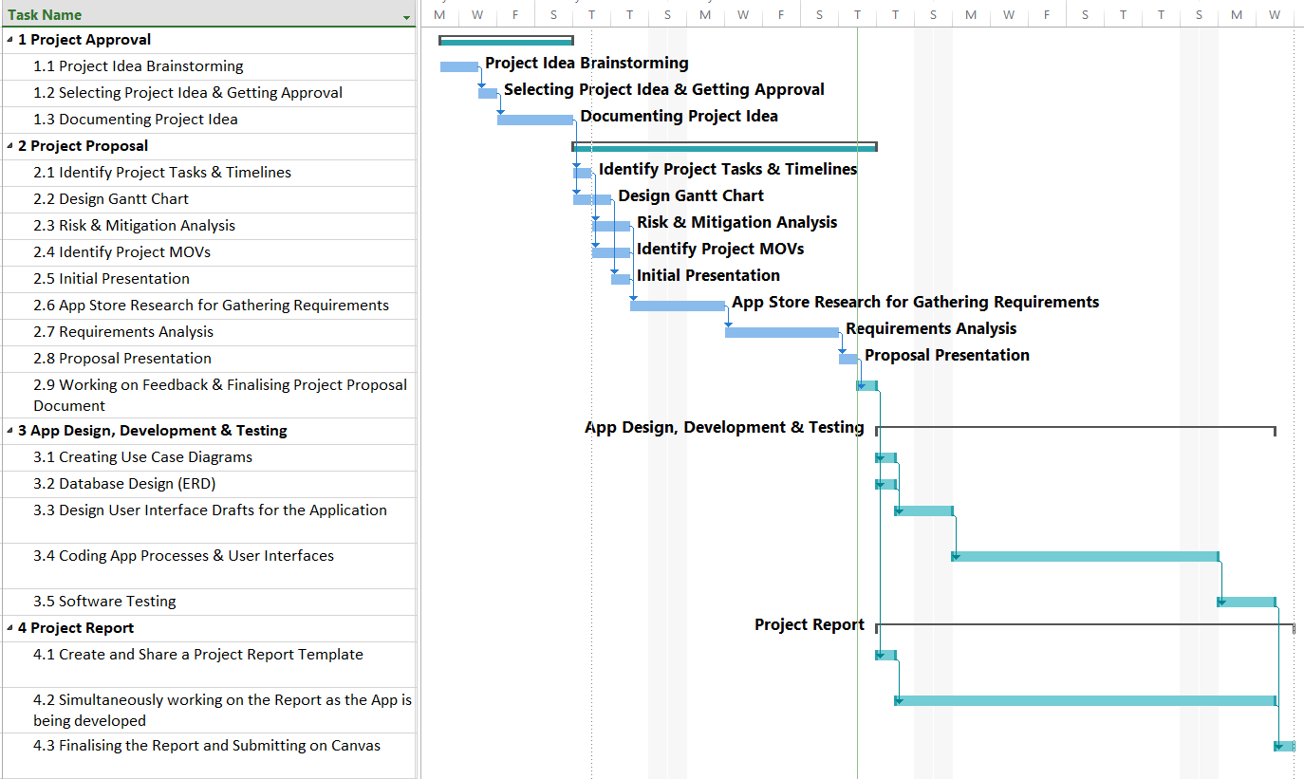
Project schedule

Slide 7
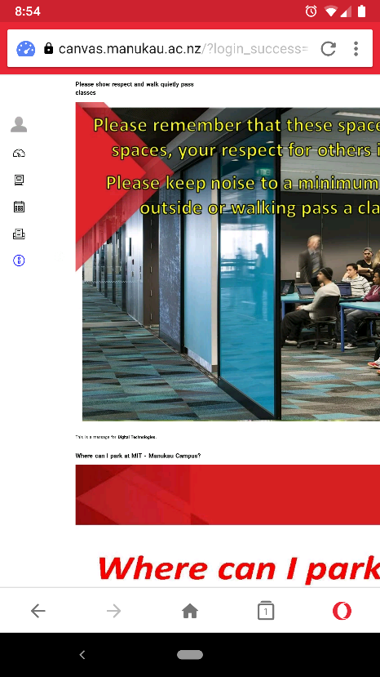
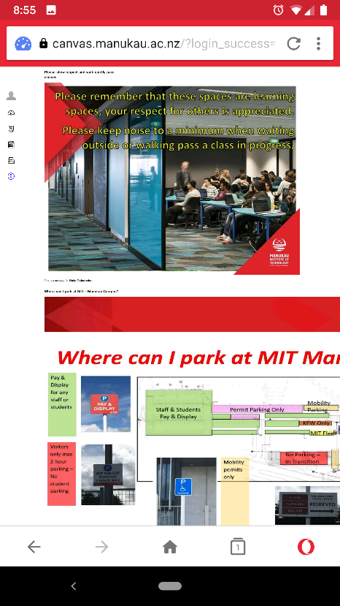
Literature Review
Existing System in Place
MIT Student Canvas
Limitation of Knowledge Sharing outside classrooms/course
Not mobile friendly (Web version only)
Not Easily Accessible

Slide 8
App Comparisons
Application Name | National American University | Studydrive – The Student Platform | BRAINYOO Flashcard Application | StudySmarter - Your learning application for university | AUC Mobile
Developer | National American University | Studydrive GmbH | Brainyoo Mobile Learning GmbH | StudySmarter | The American University in Cairo
Target Age | 3+ | 12+ | 3+ | 3+ | 3+
Rating | 3.6 | 4.5 | 4.3 | 4.2 | 4.3
No. of Reviews | 19 | 259 | 2,590 | 156 | 16
Downloads | 1,000+ | 10,000+ | 100,000+ | 50,000+ | 1,000+
Design Trend | Semi Tiles | Material Design | Open Plain Design with graphs | Cards & Semi material | Tiles Design
Application Category | Education | Education | Education | Education | Education

Slide 9
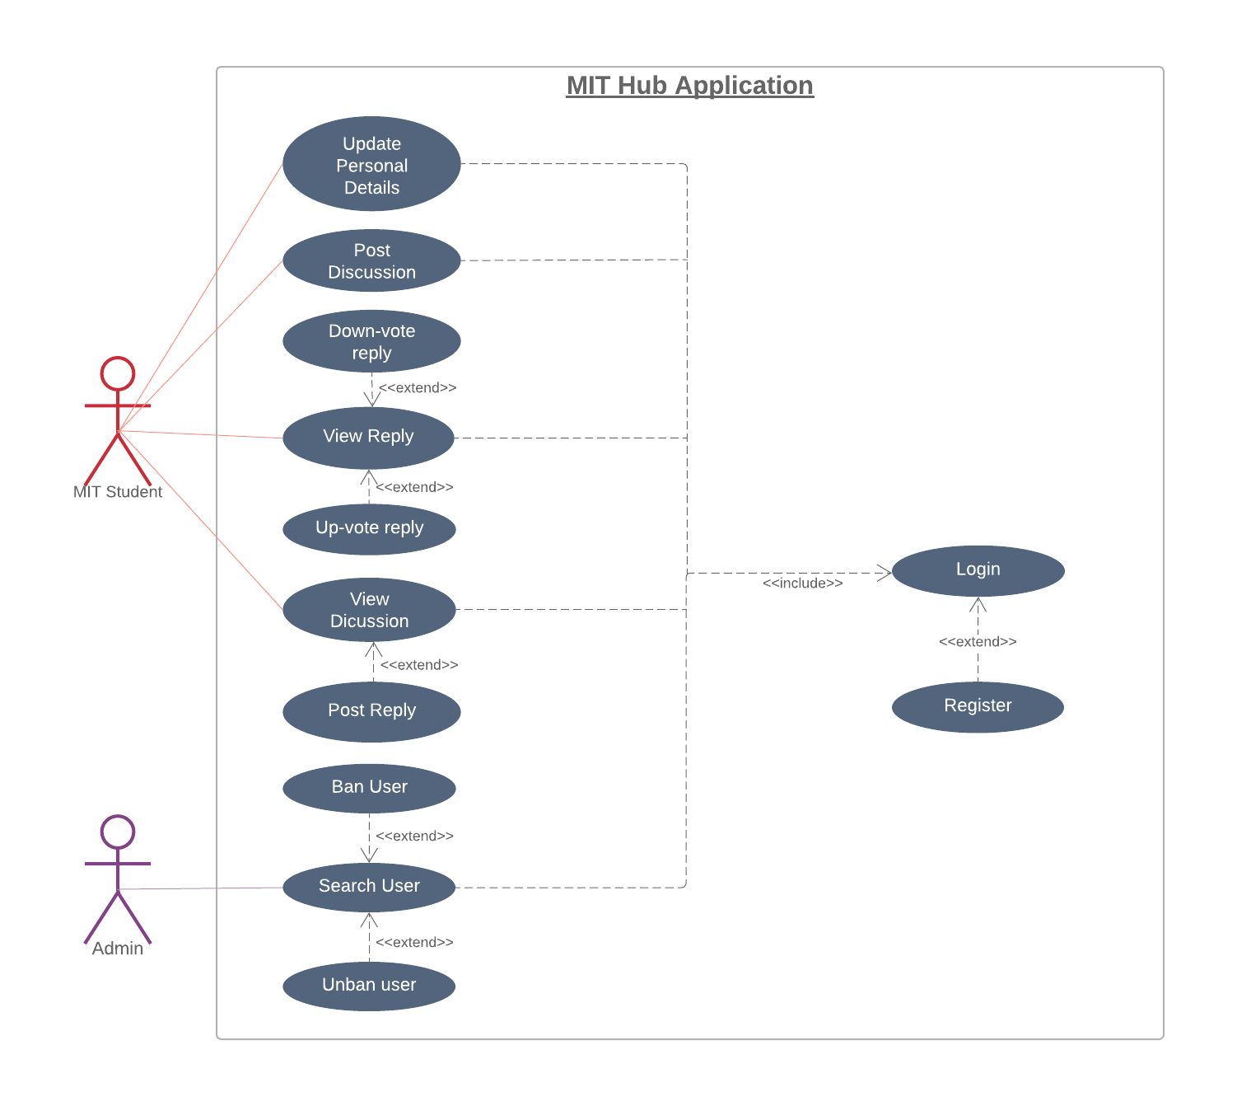
Use Case Diagram

Slide 10
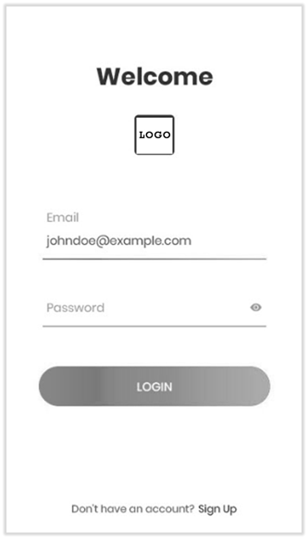
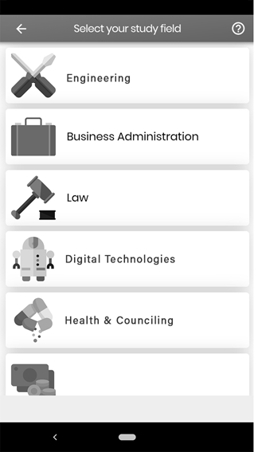

Draft Designs

Slide 11
References
Alexandra, J. (2018, February 09). Measurable Organizational Value. Retrieved from Binus University School of information Systems: https://sis.binus.ac.id/2018/02/09/measurable-organizational-value-mov/
Manukau Institute of Technology. (2018). Plans and Strategies. Retrieved May 30, 2019, from Manukau Institute of Technology Website: https://www.manukau.ac.nz/about/about-the-institute/plans-and-strategies
Manukau Institute of Technology. (n.d.). Areas of Study. Retrieved May 29, 2019, from Manukau Institute of Technology Website: https://www.manukau.ac.nz/study/areas-of-study
Studydrive GmbH. (2019, May 14). Studydrive GmbH (2.76) [Mobile Application Software]. Studydrive GmbH. Retrieved May 30, 2019, from https://play.google.com/store/apps/details?id=de.veedapp.veed&hl=en_US
StudySmarter. (2019, May 23). StudySmarter - Your learning app for university (1.2.0) [Mobile Application Software]. StudySmarter - Your learning app for university. Retrieved May 30, 2019, from https://play.google.com/store/apps/details?id=com.studysmarter
The American University in Cairo. (2019, May 23). AUC Mobile (1.3.1) [Mobile Application Software]. AUC Mobile. Retrieved May 30, 2019, from https://play.google.com/store/apps/details?id=auc.edu
National American University. (2018, August 9). National American University (1.2) [Mobile Application Software]. National American University. Retrieved May 30, 2019, from https://play.google.com/store/apps/details?id=edu.national.dist
Brainyoo Mobile Learning GmbH. (2019, May 13). BRAINYOO Flashcard App (2.8.7) [Mobile Application Software]. BRAINYOO Flashcard App. Retrieved May 30, 2019, from https://play.google.com/store/apps/details?id=com.brainyoo.brainyoo2
Harvey, R. (2012, March 9). Is the Waterfall software development methodology still viable? Retrieved from Stack Exchange: https://softwareengineering.stackexchange.com/questions/139013/is-the-waterfall-software-development-methodology-still-viable

Slide 12

Questions?

